Slide 1
Thermo Lab 3 - Design Lab
ASEN 3113 Fall 2020
Cody Watson | 108988282 | Cole MacPherson | 108521329 | Andrew Komitor | 109306168
Nate Kuczun | 108724060 | Max Morgan | 106522203 | Mary Sobernheim | 109419094

Slide 2
Presentation Overview
Max Morgan - Problem Statement / Design Requirements
Andrew Komitor - Design Requirement Details / Flight Heritage Details
Mary Sobernheim - Design Requirement Details / Radiation Area Estimation
Cody Watson - Radiator Design Overview / Validating Results
Nate Kuczun - Q_{in} / T vs. Time Results / Code Overview & Validation
Cole MacPherson - Q_{in} / T vs. Time Results / Design Alternatives

Slide 3
Problem Statement
Design a radiator that allows the GOES-16 satellite instrumentation to retain a high level of data accuracy over a 10 year mission lifetime by maintaining thermal limits of the instrument and spacecraft
Notes:
Geostationary Operational Environmental Satellite
Launched 2016
US Weather + Forecast Monitoring

Slide 4
Design Requirements
The instrument shall draw 20W of power while operating
The spacecraft on which the instrument resides shall be located in a geostationary orbit
The spacecraft shall have one surface continually nadir pointing
The instrument shall be maintained between 20°C and 30°C in use
When the instrument is powered off, the instrument shall be maintained above -40°C
The infrared (IR) heat load from the rest of spacecraft to the radiator, at its given location, shall vary with the orbital environment.

Slide 5
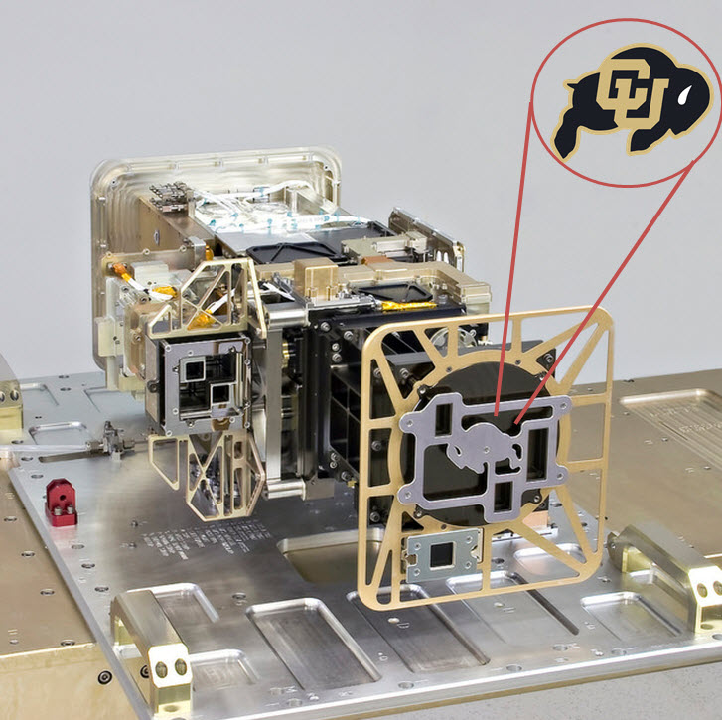
Design Requirements: Power
The instrument shall draw 20W of power while operating, which is dissipated as heat through the radiator.
Assumptions:
Any needed power is available from the spacecraft
The instrument sensor is connected to the radiator and in thermal equilibrium with the radiator.
Additional power will be used to operate the heater when necessary
GOES R-Series Sensor

Slide 6
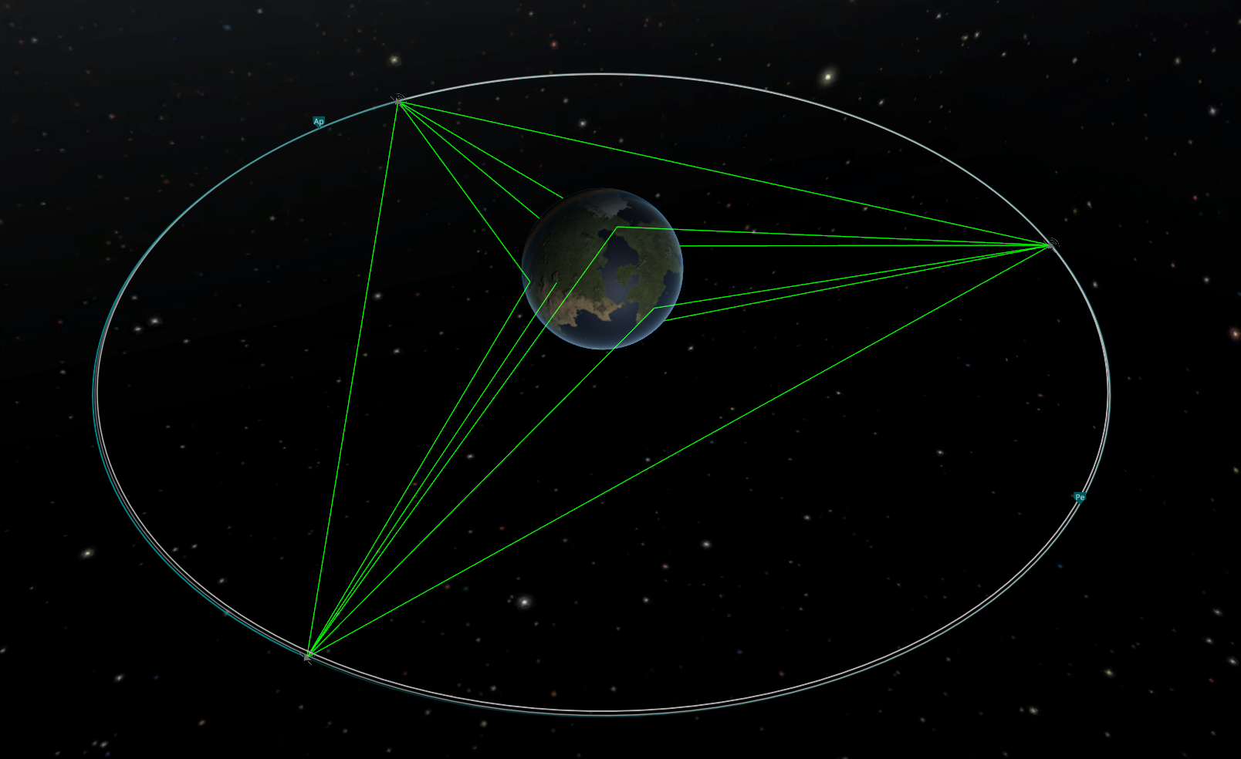
Design Requirements: Orbit
The spacecraft on which the instrument resides shall be located in a geostationary orbit.
Assumptions:
Due to the orbit altitude, Earth infrared (IR) and albedo loading can be ignored
The eccentricity of the Earth’s orbit is accounted for in the spacecraft IR backload variations
During an Equinox, an eclipse occurs for just under 1 hour and 9 minutes
Geostationary Orbit

Slide 7
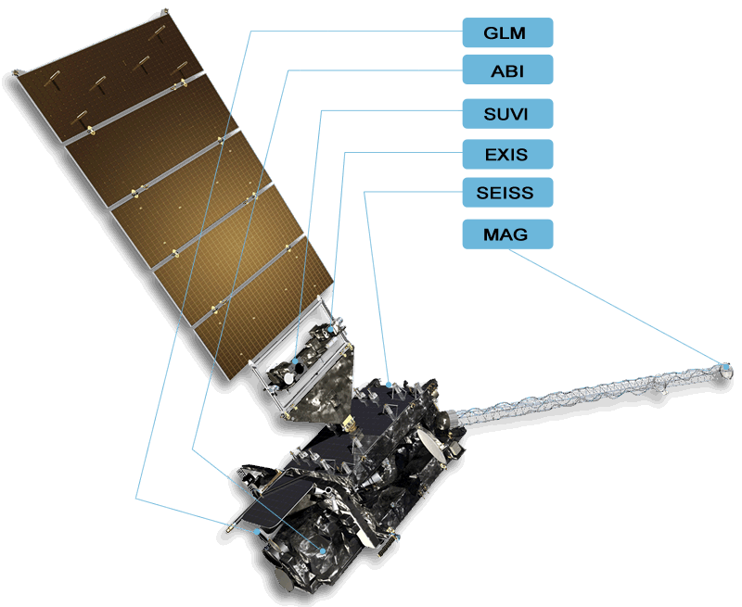
Design Requirements: Orientation
Surface: The spacecraft shall have one surface continually nadir pointing.
Mounting: The radiator shall be rigidly mounted on the trailing surface, opposite to the ram direction or velocity vector of the spacecraft.
The heating of the radiator will fluctuate throughout the day based on the changing angle of the radiator with respect to the sun.
GOES 16 Satellite

Slide 8
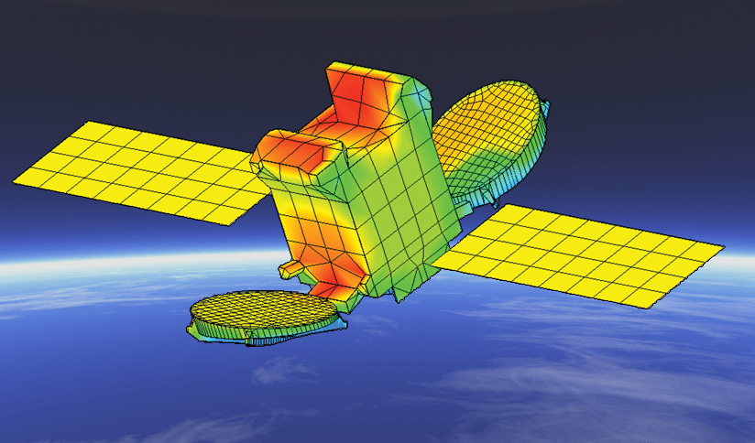
Design Requirements: Thermal
Operational: The instrument shall be maintained between 20°C and 30°C in order to acquire science data accurately.
Survival: Maintain temperature > -40°C to prevent any damage from occurring during passive operation
These will both be accomplished by applying a heat input via an instrument heater when necessary.
Satellite Thermal Map

Slide 9
Design Requirements: Spacecraft IR Backload
The infrared (IR) heat load from the rest of spacecraft to the radiator, at its given location, shall vary with the orbital environment.
The following IR backload values were used:
Note: During the equinoxes, the IR Backload is just the average of the values at Winter and Summer Solstices, except during eclipse.
Winter Solstice: 88 W/m2
Summer Solstice: 63 W/m2
Eclipse: 11W/m^2

Slide 10

Radiation Area Estimation
Q_{rad} = εσAT⁴ (1)
?
Governing equation (1) is Stefan-Boltzmann Law, giving radiated power as a function of temperature
Size determined by solving minimum area of the radiator via several size iterations such that it meets the design requirements
Initial conditions:
Starting area A of 1 m²
Solar absorptivity 𝛼 of 0.2
Emissivity ε of 0.85
Assumptions:
The radiator’s maximum operating temperature shall be the median value of the thermal range, 303 K (30 ℃)
?
Notes:
MARY
https://www.engineeringtoolbox.com/radiation-surface-absorptivity-d_1805.html

Slide 11
Design Software Overview
Thermal Graphs
Radiator Sizing
Set constants
Set constants
Pick orbit position
Pick orbit position
Set radiator size guess
Radiator theta function
Calc Qin from solar heating, IR backload, Instrument
Qin from solar heating, IR backload, Instrument
Energy balance → Heater to maintain temperature
Calc Q dissipated required
Q / Temperature graphs over time
Calc Radiator required
Compare max radiator sizes

Slide 12
Radiator Design Overview
0.5352 m
Design Characteristics:
Material: Anodized Aluminum
Surface Area: 0.2864 m²
Emissivity: 0.85
Absorptivity: 0.2
Anodized Aluminum Properties¹:
Emissivity: 0.84
Absorptivity: 0.14
0.5352 m
Surface Area:
0.2864 m²

Slide 13
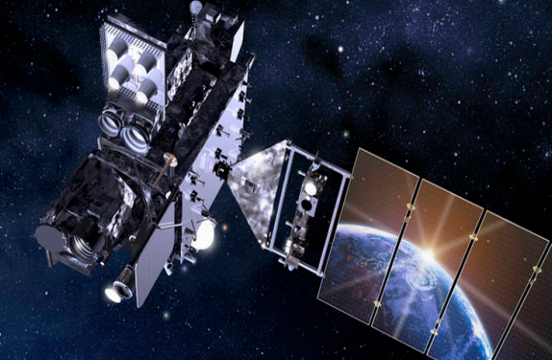
GOES - 16 Size and Comparison
GOES 16 Design and Dimensions:
Launch mass: 5,192 kg (11,446 lb)
Dry mass: 2,857 kg (6,299 lb)
Dimensions: 6.1 × 5.6 × 3.9 m
Reasonable that the designed radiator size of 0.2864 m² would fit on the satellite.
GOES 16 Satellite

Slide 14
Flight Heritage
Long Duration Exposure Facility (LDEF)⁶
Aluminum anodized with chromic acid, sulfuric acid and dyed sulfuric acid exposed to space to specifically test thermal control properties
Mars Science Laboratory (MSL)⁵
MIL-A-8625, Type II black anodic coating used on the Curiosity rover
Various types of anodization were used on the space probe itself
International Space Station (ISS)⁴
Materials International Space Station Experiment (MISSE) underwent a study to compare various types of anodized aluminum
Tested the transient response of various anodization types (such as nickel fluoride lasting 800 equivalent sun-hours)
Notes:
Thus, we chose a values similar to that of a thick coating of chromic acid anodized aluminum. The absorptivity we used was a little small compared to LDEF’s results, and the emissivity was a little large compared to LDEF, but they are the most similar of all the anodized coatings.

Slide 15
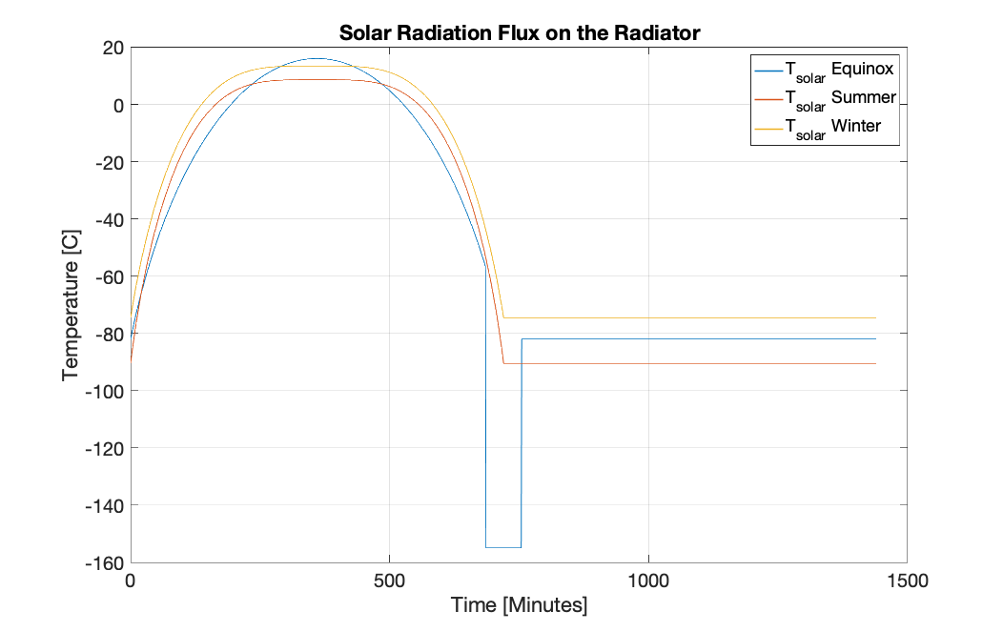
Results - Solar Radiation Flux

Slide 16
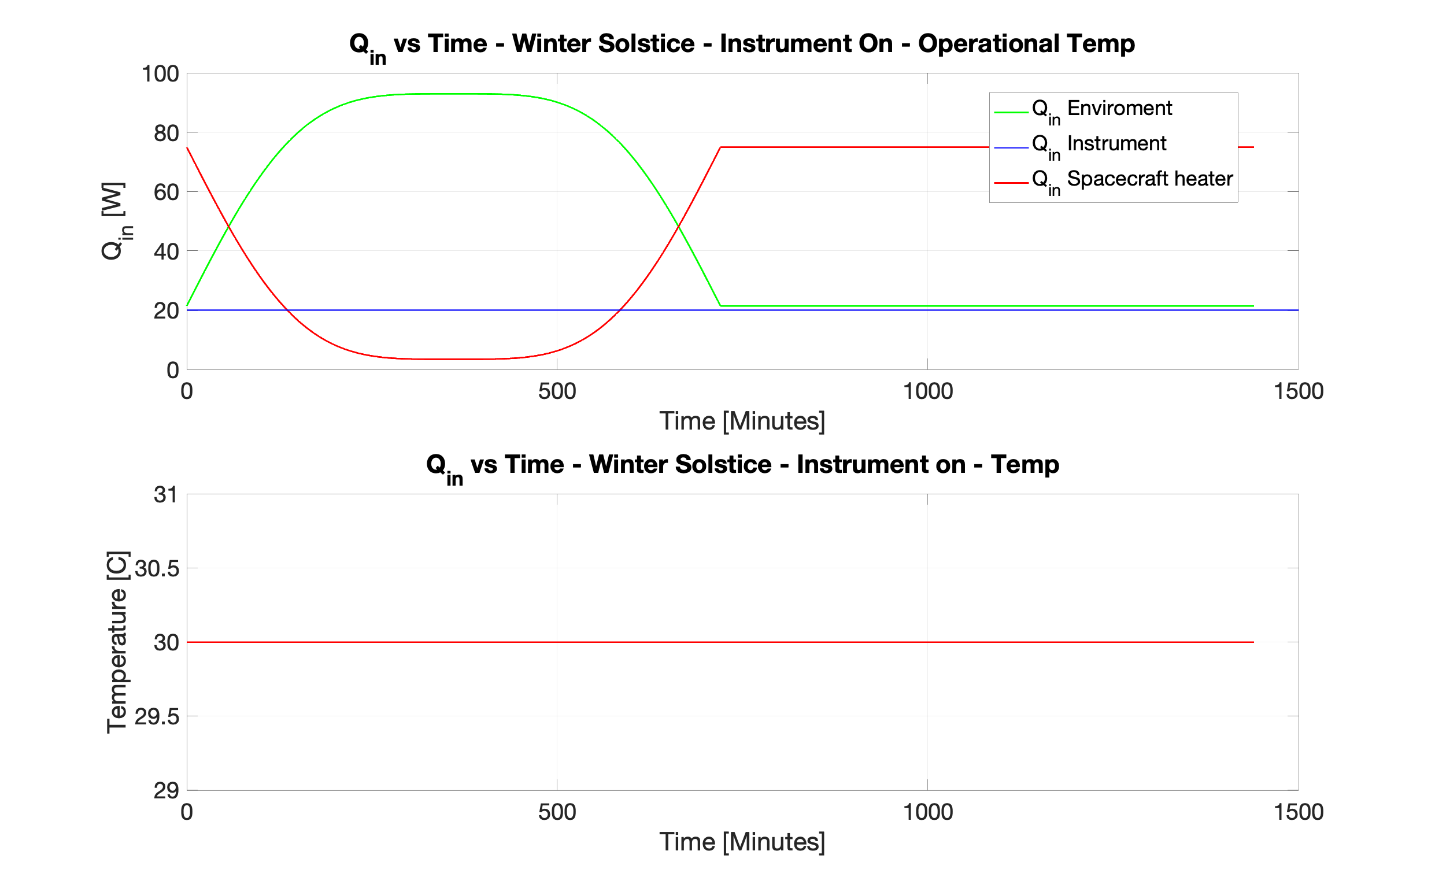
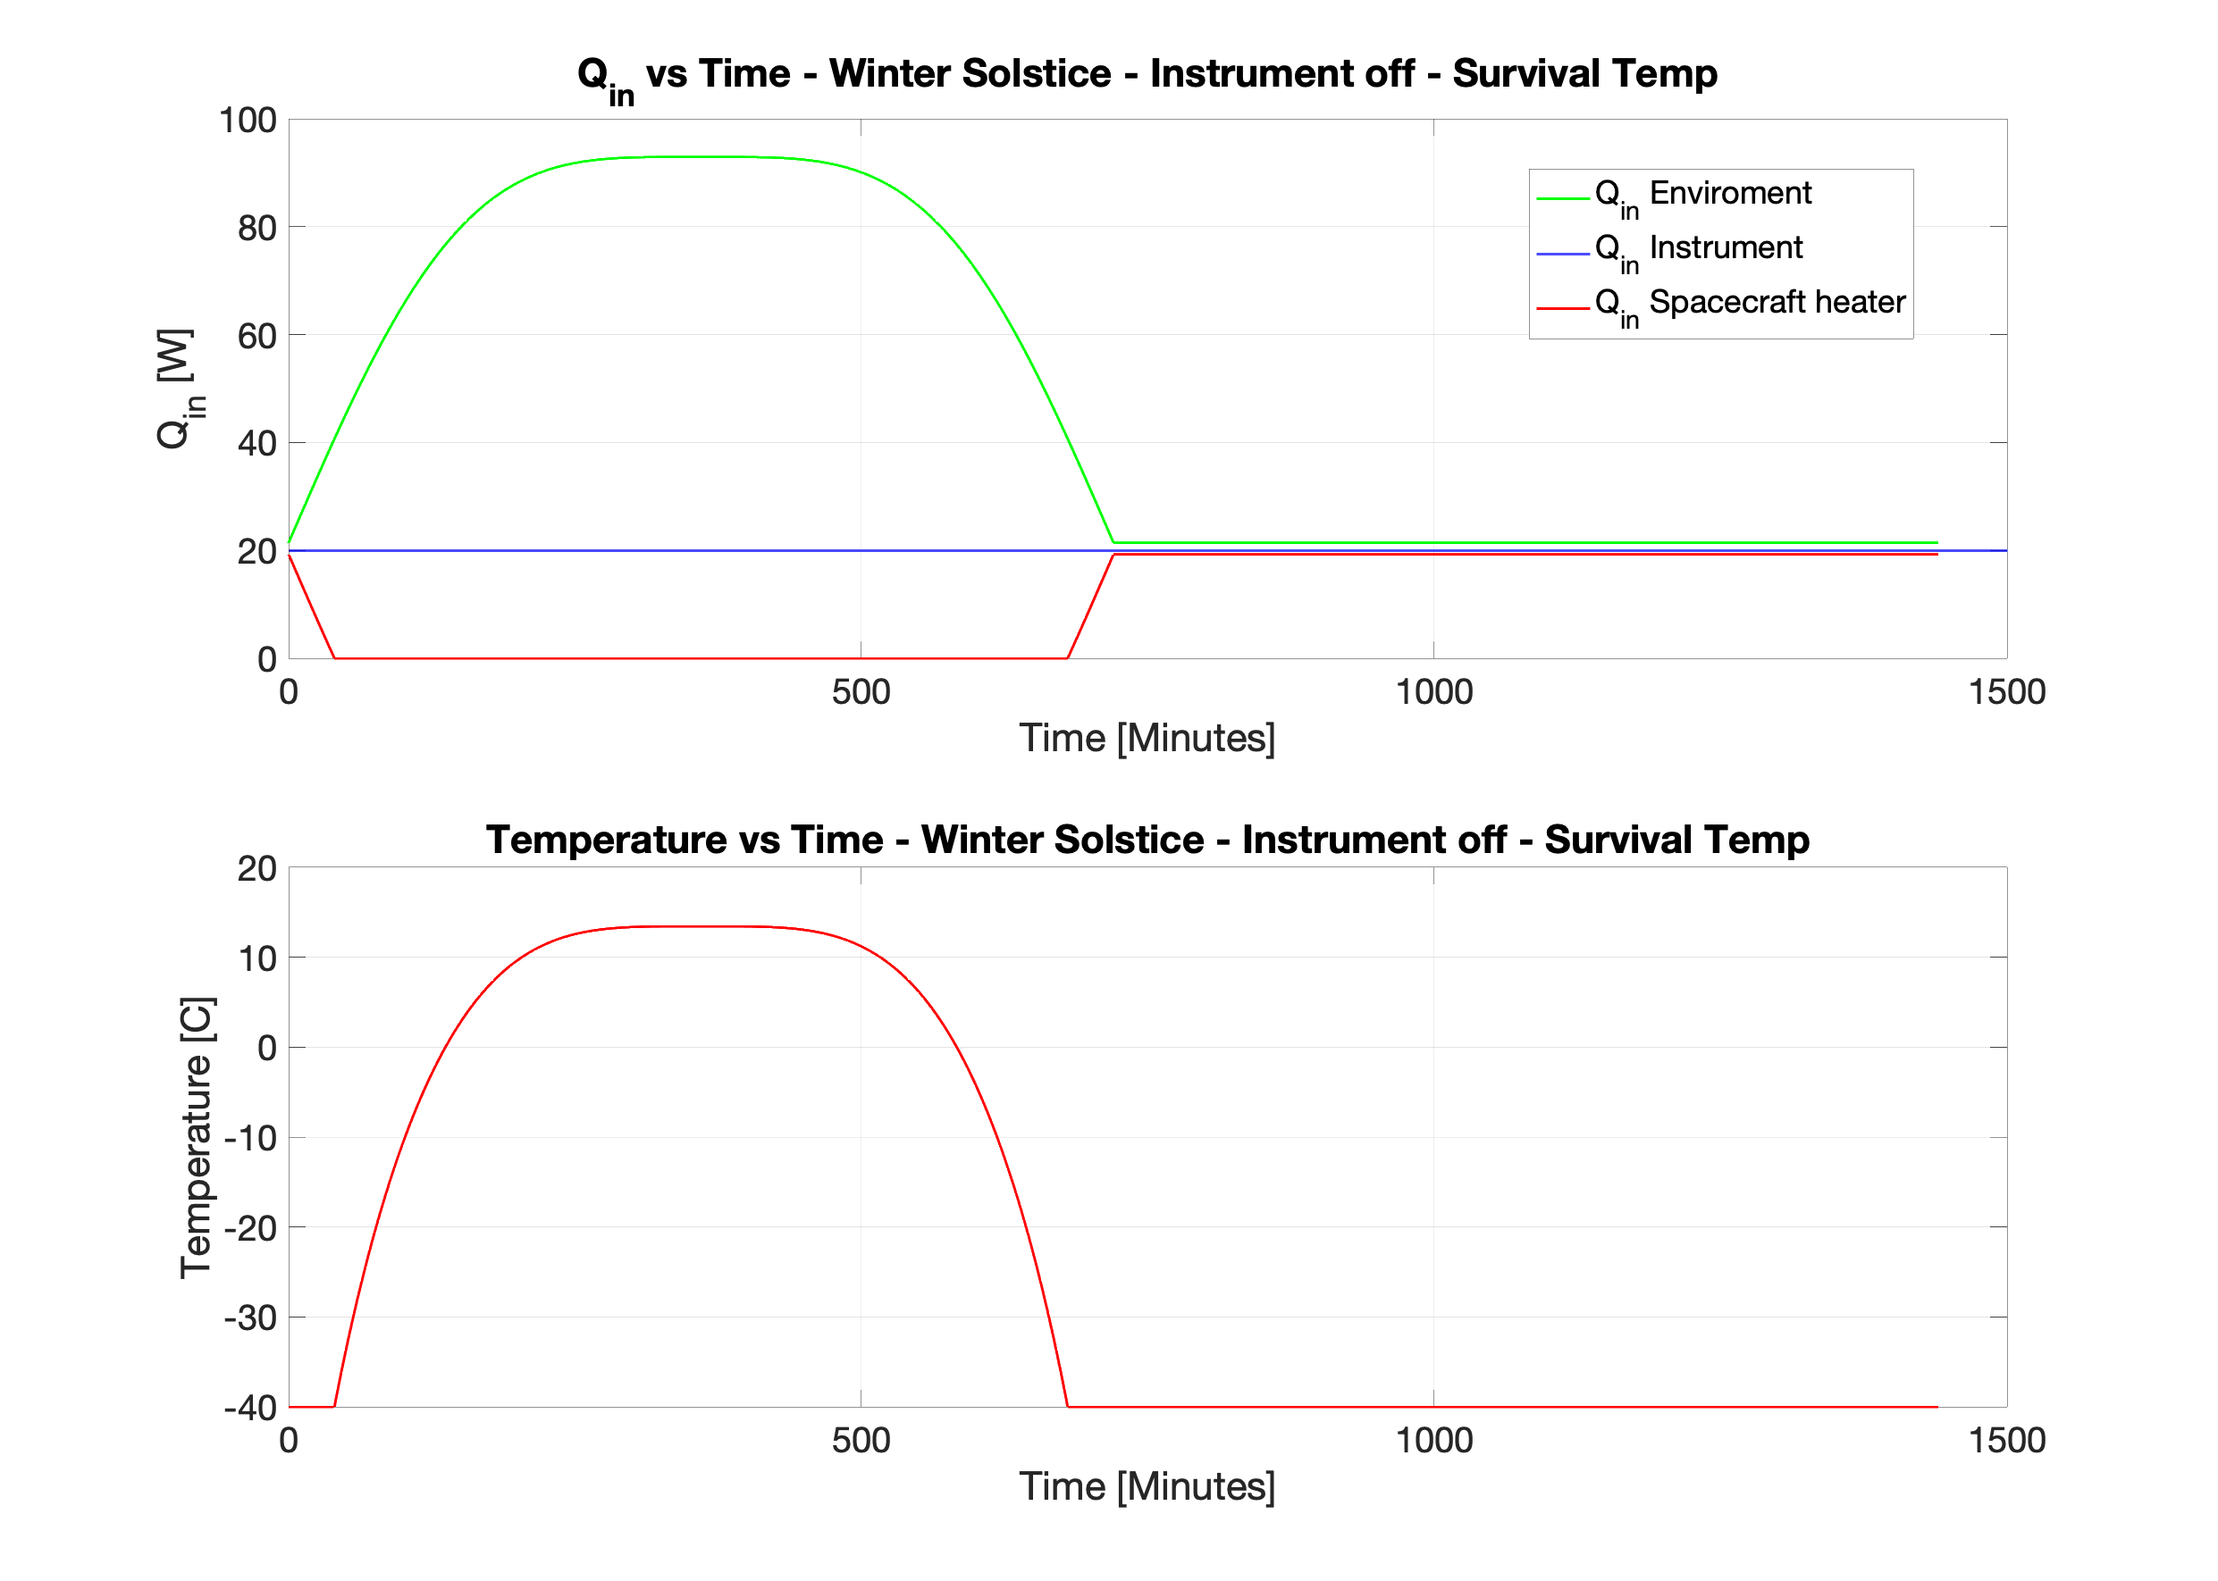
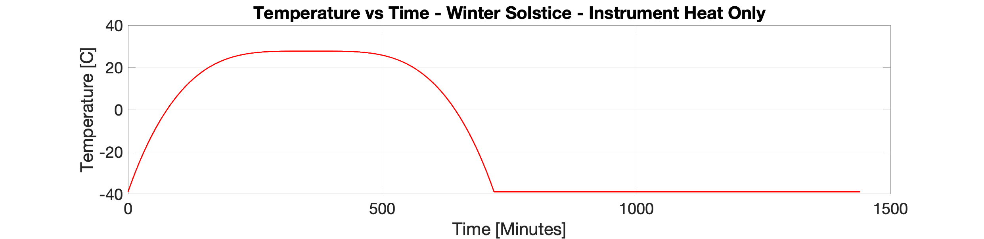
Results - Winter Solstice

Slide 17

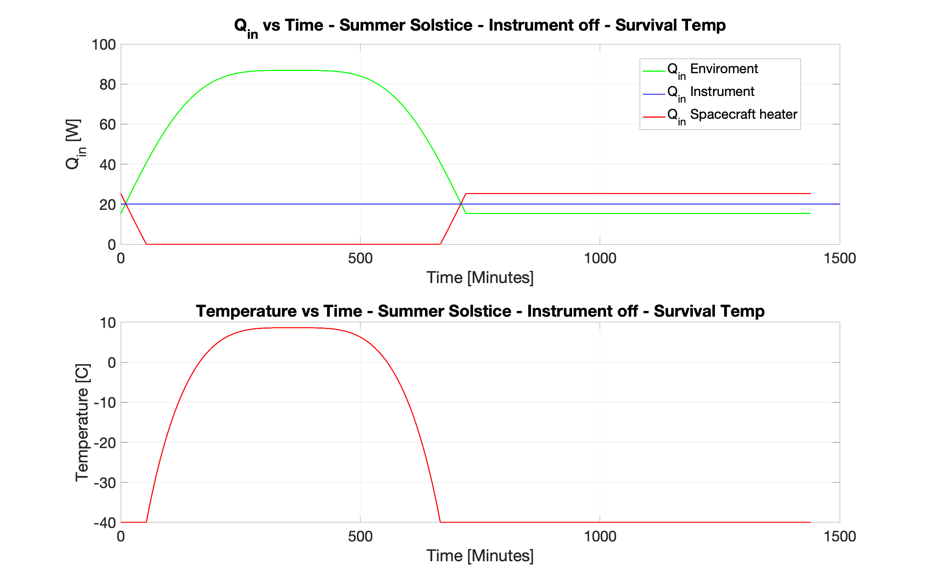
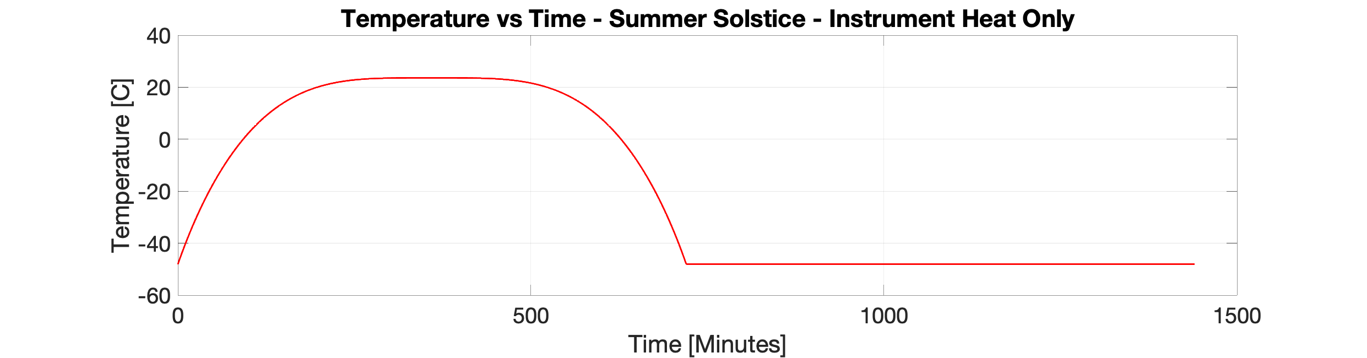
Results - Summer Solstice

Slide 18
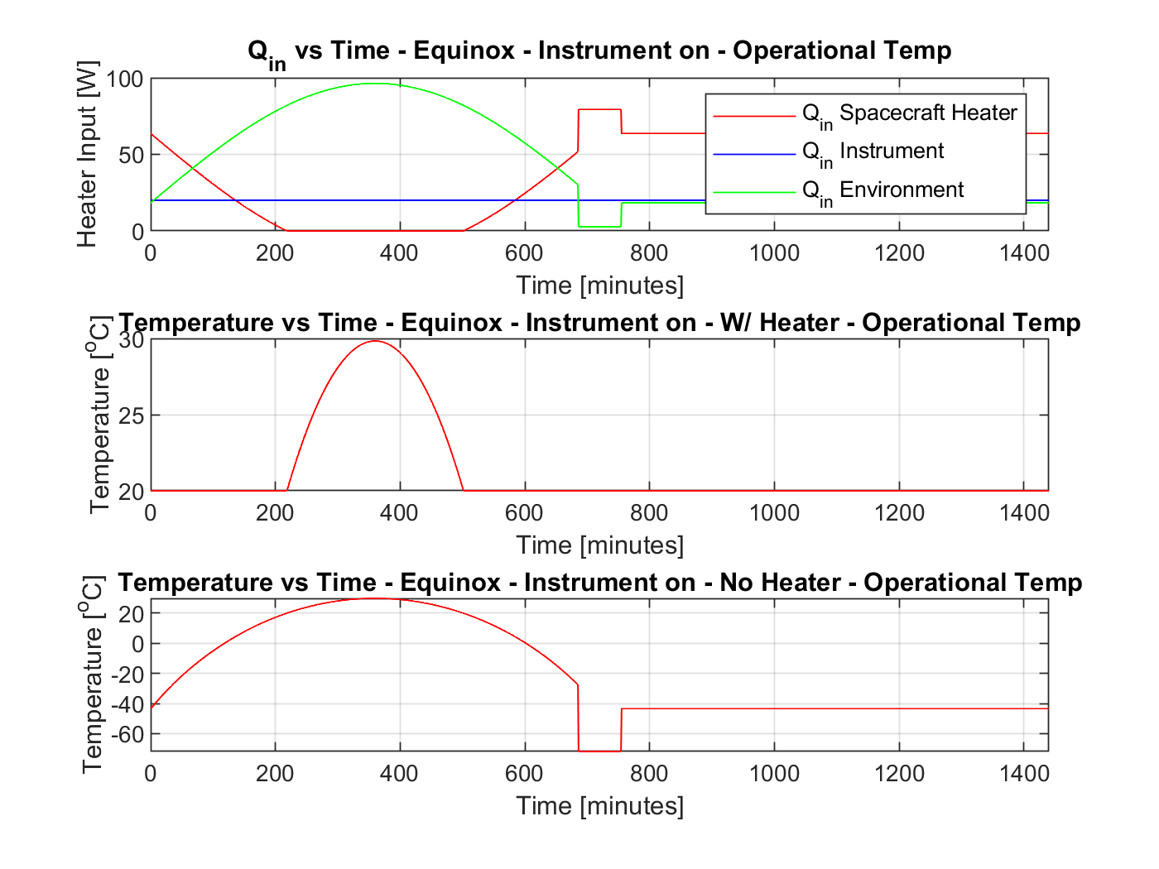
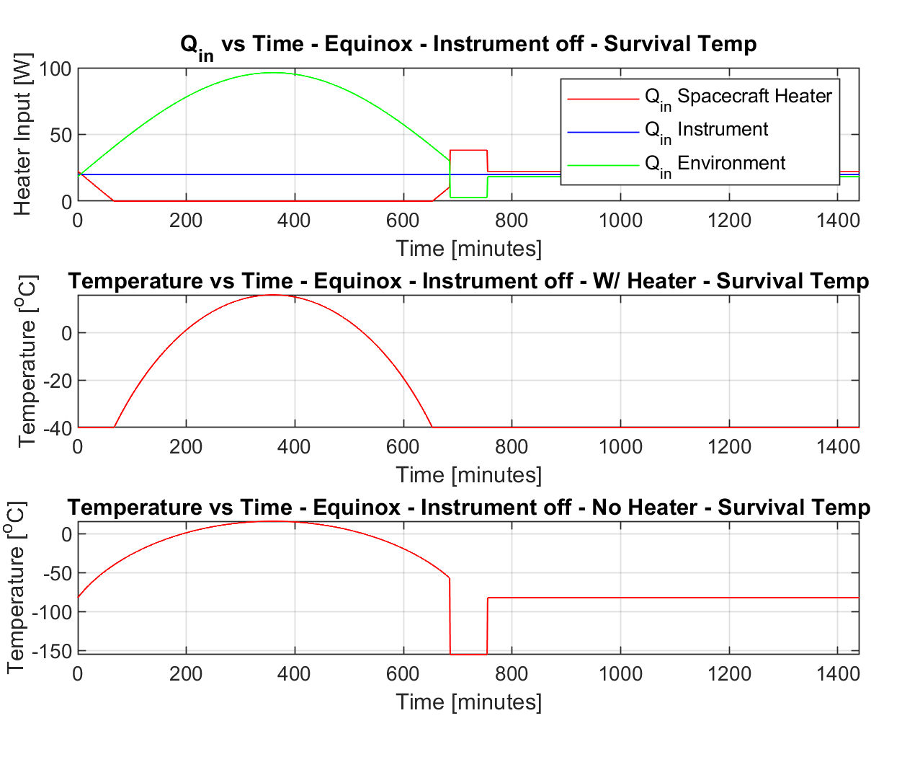
Results - Equinox

Slide 19
Design Alternatives
Pivoting Radiator
Material Coating
Multiple Radiators
Easier to pack smaller radiators over large one into fairing
More complicated thermodynamic system
Adds mechanical complexity
Flexibility of sunlight heating → less dependence on heater/electrical power
Adds mechanical complexity
Adds cost and weight
Lower absorptivity → smaller area required
Possibly deviates from flight heritage → could cause unforeseen issues in orbit
Higher emissivity → smaller area required

Slide 20
Acknowledgments
Special thank you to Professor Li for his guidance and support with this lab, as well as TA’s Robert Sasse and Lindsay Cobb for being there to answer all of our questions!

Slide 21
Sources
Table of absorptivity and emissivity of common materials and coatings. (n.d.). Retrieved November 25, 2020, from http://www.solarmirror.com/fom/fom-serve/cache/43.html
Surface - Radiation Absorptivity. (n.d.). Retrieved November 25, 2020, from https://www.engineeringtoolbox.com/radiation-surface-absorptivity-d_1805.html
Keesee, C. E. (n.d.). Spacecraft Thermal Control Systems. Retrieved November 24, 2020, from https://ocw.mit.edu/courses/aeronautics-and-astronautics/16-851-satellite-engineering-fall-2003/lecture-notes/l23thermalcontro.pdf
Finckenor, M. M., Golden, J. L., and Kravchenko, M. (2013, December). Analysis of International Space Station Vehicle Materials Exposed on Materials International Space Station Experiment From 2001 to 2011. Retrieved November 24, 2020, from https://ntrs.nasa.gov/api/citations/20140003183/downloads/20140003183.pdf?attachment=true
Jet Propulsion Laboratory (2013, August 6). Proper Use of MIL-A-8625 Type II Anodize on 2000 & 7000 Series Aluminum Alloys. Retrieved November 24, 2020, from https://llis.nasa.gov/lesson/8403
Golden, J. L. (1993, December 1). Anodized aluminum on LDEF. Retrieved November 24, 2020, from https://ntrs.nasa.gov/search.jsp?R=19940026512

